Slide 1
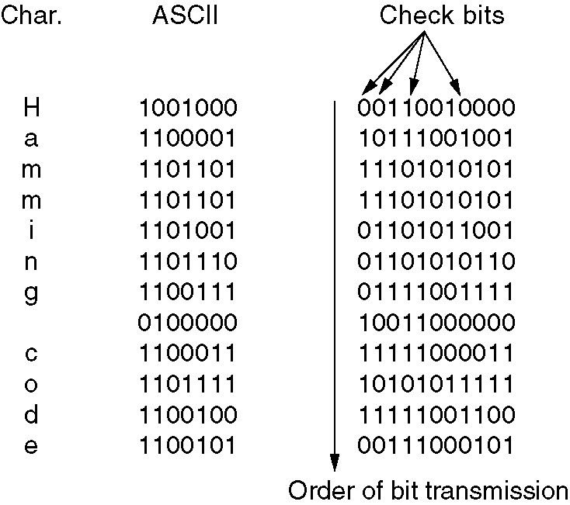
Burst Error Correction Using Hamming Code
Use of a Hamming code to correct burst errors

